Slide 1
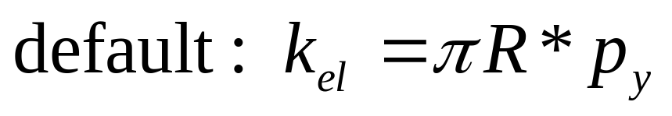
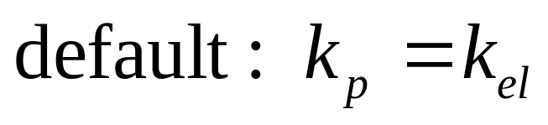
Additional input parameters, compared to Hertz-Mindlin model
Surface energy, Г
Lower limit of elastic stiffness, k_{el}
Yield contact pressure, p_{y}
Plastic stiffness, k_{p}
Input prefs file for the code (ContactModelPrefsFile.txt):
Input | surfaceEnergy(J/m²) | yieldPressure(Pa) | elasticStifnessRatio | plasticStifnessRatio | plasticDampingFactor
symbol | Г | p_{y} | k_{el}/πR*p_{y} | k_{p}/k_{el} | β
default value | - | - | 1.0 | 1.0 | 0.1
k_{el} and k_{p} scale with particle radius
very suitable for wide PSD
example:
#surfaceEnergy(J/m2):yieldPressure(Pa):elasticStifnessRatio:plasticStifnessRatio:PlasticDampingFactor
NewParticle:NewSection 0.24 30000000 1.0 1.0 0.1
Note: particle name and geometry name should not like “New Particle” or “New_Particle”
Excel Tool: “LEPA_Parameters.xlsx” provides a quick estimation of the contact parameters

Slide 2
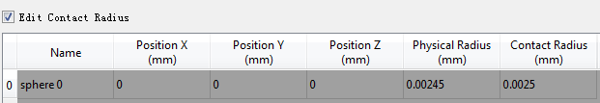
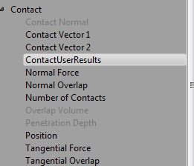
Contact radius:
a little larger than physical radius, R+(2-10)α_{fe}
α_{fe} from Excel Tool
Model results:
4 elements (SI unit):
Element 0- maximum overlap at which plastic unloading starts
memoried until the contact disappears
Element 1- state of physical contact (contact if =1)
Element 2- state of yield loading (yield loading if =1)
Element 3- normal force magnitude
state of force: tensile (<0) or compressive (>0)
Model simplification:
If no cohesion, input 0 for Г → linear elastic-plastic model
If no plastic, input very large value for p_{y} and re-scale k_{e} → linear elastic-cohesive model

Slide 3
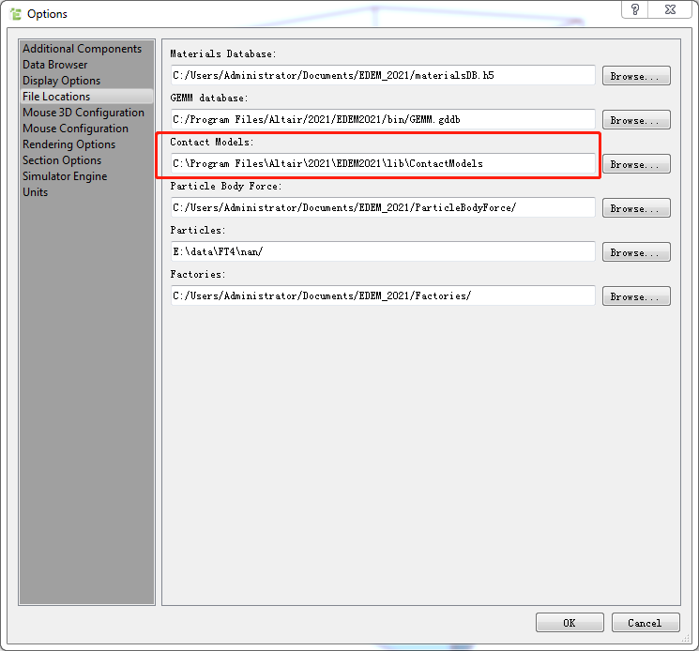
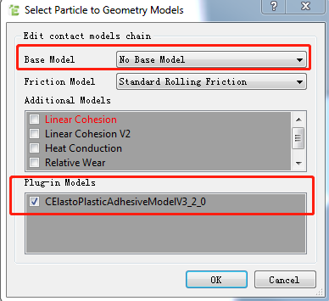
Use in EDEM:
Step 1:
Step 2: Put “ContactModelPrefsFile.txt” in the same folder as the “.dem” file
Step 3: edit contact chain
put “.dll” file in this directory
Examples of simulation files are also provided

